Slide 1
Welcome to
Curriculum Night
2022-2023
Grade 7

Slide 2
Meet Mrs. Timme
Starting my career with Northwest Local School District, I soon made the decision to teach in the Diocese of Covington, where I taught language arts, literature, and religion for 23 years.
I earned a Bachelors in Arts and Science (Elementary Education) from the College of Mount Saint Joseph, a Masters (Multicultural Literature for the Middle Grades) from Xavier University, and an Endorsement for English and Communications from Northern Kentucky University.
I enjoy spending time with family. Playing a rousing game of pickle, participating in a competitive game night, and sitting around a camp fire sharing stories and laughter are family favorites.

Slide 3
Contact Information
Email b.timme@stgabeschool.org
You can also reach me through the school office.
Call (513)771-5220 to leave a message with Mrs. Gutman.
When leaving a message, please include specific information so that I can be prepared with relevant materials in front of me when I contact you.
Please send information regarding absence, late arrival, or early pick up to Mrs. Gutman a.gutman@stgabeschool.org
I will check my email before and after school, but I will not check my email in the evening or on weekends as this is family time.

Slide 4
Expectations
Our focus is on LEARNING, so we expect students to help us create an environment that is going to help them and those around them have the greatest success in learning.
Students are expected to be kind, respectful, prepared, active participants in class, and persistent. If students are actively engaged in their learning, we will have an amazing year!

Slide 5
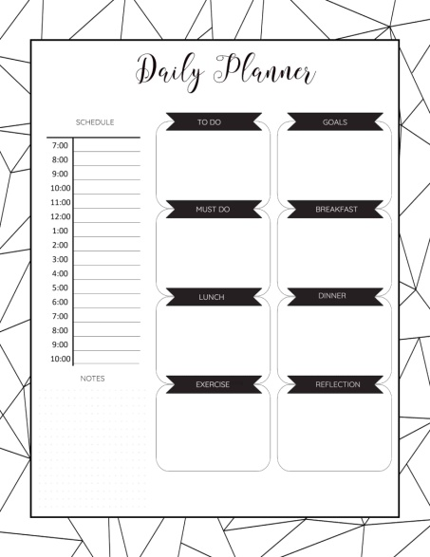
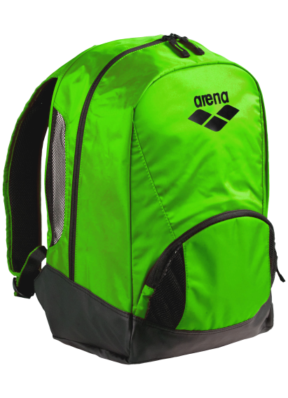
Weekday To-Do List
Review the assignment book with your child to check for assignment completion.
Encourage your child to pack their backpack after all assignments are completed so that they are organized and ready for the next morning.

Slide 6
Thursday To-Do List
Check Progress Book and look at all office announcements.
Check graded papers for the week.
Check the demerit card (both sides) and sign the card.
Give your child a high five
for no demerits during
the week.

Slide 7
Language Arts
Our focus is to help the students develop their skills in grammar and vocabulary in order to communicate effectively in writing.
We will also be working on oral communication skills (book presentations, poetry, small group presentations, oratory, etc.).
Finally, we will work on nonverbal communication skills.
Class time is a combination of grammar, writing, Daily Editing Review, Greek/Latin roots, and Vocabulary Workshop.
We will work on short and long writing pieces, building up to the final writing project.
Technology will be a part of class, but we will also continue to do
handwritten work.

Slide 8
Literature (Reading)
Our focus is on deepening our understanding of literary elements, understanding the structure and purpose of different types of writing, expanding our understanding of context clues for unfamiliar words and ideas, and enjoying the experience of reading for pleasure. We will also work on increasing the pace of reading while maintaining comprehension.
We will be reading fiction and nonfiction, and will often tie in our writing and religion units with our reading selections.
We will be participating in AR this year.
Some of our reading selections: short stories, classic authors (Poe, Whitman, Hughes, O. Henry, Dickens),folktales, novels (possible titles: Out of the Dust by Karen Hesse, Inside Out and Back Again by Thanhha Lai, Words on Fire by Jennifer A. Nielsen, The Hidden Girl by Lois Metzger and Lola Rein Kaufman, and Sophia’s War: A Tale of the Revolution by Avi.

Slide 9
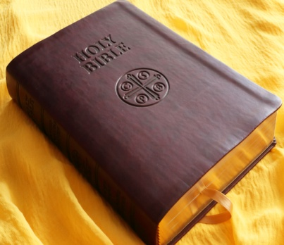
Religion
Students will be empowered to live their faith in every
aspect of their daily lives.
Through text, Scripture, utilizing a Common Place book,
participating in Mass, and being aware of the needs of
others, students will grow and become more active
participants in their faith.
Students will become more familiar with prayer and their
communication with God, developing an awareness of their relationship with Him.
Students will have the opportunity to observe the lives of saints, reflect on their own path in life, and respond in positive ways.
*Please encourage your child to read Scripture every day, possibly
with you, and discuss its meaning and how it relates to us today. Prior to going to Mass over the weekend, use USCCB.org to
pre-read the Scripture readings so that, as a family, you can better
understand the Scripture message.

Slide 10
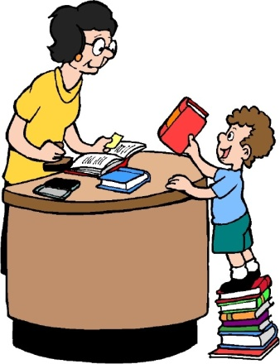
Grading
Final grades are a combination of class work, homework, and test/quiz grades.
Grades are determined by points over the course of the trimester (the total number
of points earned divided by the total number of points possible).
All tests and quizzes MUST be signed by the student’s
parent/guardian and turned in the day after it was returned to the student.
Please check Progress Book on Thursday nights (after 5 p.m.) for
any grades marked as “Missing” (identified with a red M and
counted as a zero). If it is listed as missing on Thursdays, your child
has NOT turned in that assignment.
Homework is worth 5-25 points.
Quizzes are worth 25-74 points.
Tests are worth 75-100 points.
Projects are worth 100 points
Written assessments will vary in value.

Slide 11
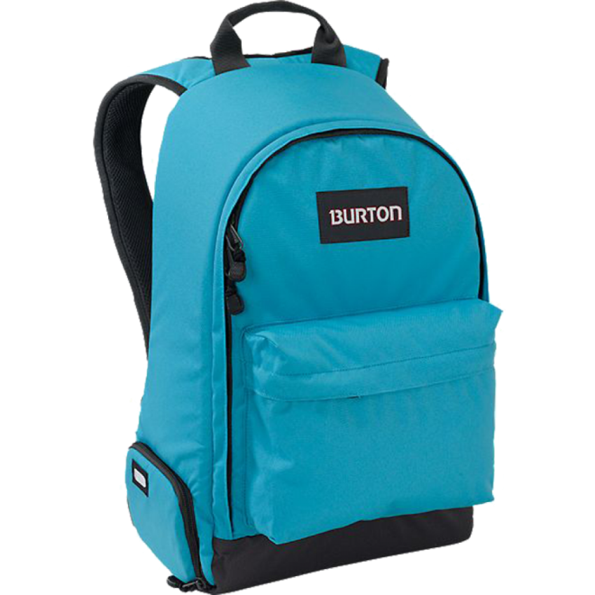
Technology Notes
Discuss the proper use of iPads with your child. An iPad is a
learning TOOL, not a toy. Technology can be a useful work tool, and
our focus is to teach students how to use it to work efficiently.
The school iPad should be used ONLY for school work.
Review the “Responsible Use of Technology” policy with your child.
1. Your child must bring his/her iPad, fully charged, to school each
day.
2. We will not use it for all assignments, but it should be ready when
we need it.
We will use Google Classroom (GC) as our platform for assignments.
Mrs. Gerth and Mrs. Klenke will be working with the classes as soon
as school starts to make sure they are comfortable with GC.
Your child should NOT bring other devices to class-no smart
watches are allowed, and phones must remain IN backpacks
and be turned OFF.
PHONE
INSIDE & OFF

Slide 12
Google Classroom (GC)
Assignments will be posted on Google Classroom by 4 p.m.
Whether we are doing remote learning or not, we will use GC for some assignments.
Assignments on GC are due in the same way that handwritten assignments are due; students must follow directions, complete the assignments, and turn them in on time in order to earn full credit.

Slide 13
Please and Thank You
Please make sure your child has a non-metal water bottle that closes tightly-we are only using water fountains as bottle fillers.
Please make sure your child wears deodorant each day. Thank you!
Please make sure your child’s belongings are labeled-jackets, sweatshirts, pencils, etc.
Please let your child be accountable for their own actions and the consequences of his/her actions.
Please remind your child to ask for help when he/she needs it!
Please be on time for school and for dismissal-remember that school hours are 8 a.m.-2:45 p.m. We start school at 8 a.m. and students are to be ready to start their day at that time, not walking into the room at 8 a.m. We must see you in order to release your child to you at the end of the day. If you are not there, you need to report to the office to pick up your child.
THANK YOU for your support and for encouraging your child to be excited about 7th grade!

